Slide 1



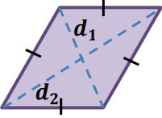
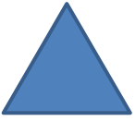








Area and Volume 1
Area of different shape
2
l
Area of square
$$=$$
l
h
Area of parallelogram
$$=$$
bh
l
b
w
Area of rectangle
$$=$$
lw
d
d
Area of rhombus
$$=$$
1
2
2
l
b
1
bh
b
$$+$$
b
Area of triangle
1
2
h
$$=$$
h
Area of trapezium
$$=$$
2
2
b
b
2

Slide 2

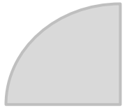
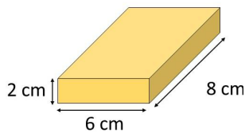
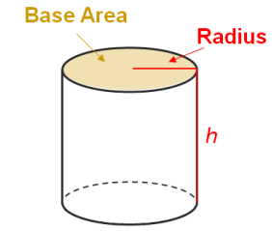











r
2
2
$$θ$$
$$=$$
$$π$$
r
$$=$$
$$π$$
Area of circle
Area of Sector
r
$$×$$
360
$$θ$$
r
Volume of Prism
Volume of Prism
$$=$$
base area
$$×$$
h
$$=$$
$$π$$
2
Volume of cylinder
r
h

Slide 3
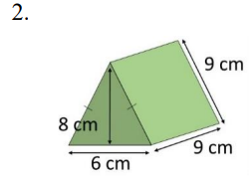
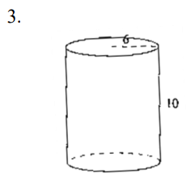














Volume of Prism
$$=$$
base area
$$×$$
h
8
$$×$$
6
$$=$$
$$×$$
9
2
$$=$$
216
3
cm
$$=$$
$$π$$
2
Volume of cylinder
r
h
2
$$=$$
$$π$$
(
$$×$$
10
6)
$$=$$
$$π$$
360

Slide 4
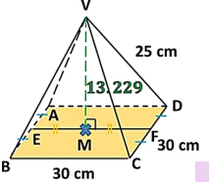

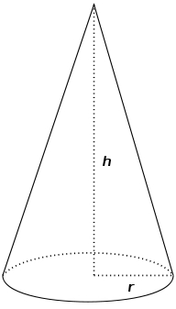






Volume of Pyramid
1
Volume of Pyramid
$$=$$
$$×$$
base area
$$×$$
h
3
1
2
Volume of Cone
$$=$$
$$×$$
$$π$$
r
h
3

Slide 5
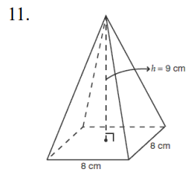
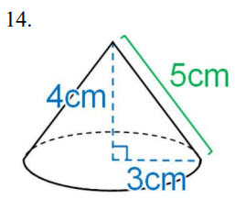
















1
Volume of Pyramid
$$=$$
$$×$$
base area
$$×$$
h
3
1
2
$$=$$
$$×$$
(
$$×$$
9
8)
3
$$=$$
192
3
cm
1
2
Volume of Cone
$$=$$
$$×$$
$$π$$
r
h
3
1
2
$$=$$
$$×$$
$$π$$
(
$$×$$
4
3)
3
$$=$$
$$π$$
3
12
cm

Slide 6
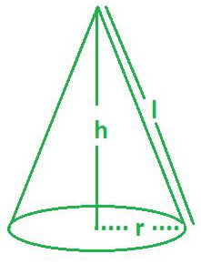
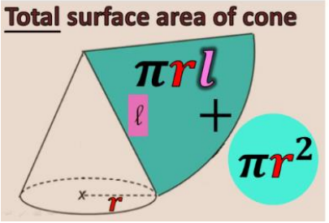








Surface area of cone
Curved surface area of cone
$$=$$
$$π$$
r
l
Total surface area of cone
$$+$$
Curved surface area of cone
$$=$$
base area
$$π$$
2
$$π$$
$$=$$
r
$$+$$
r
l

Slide 7
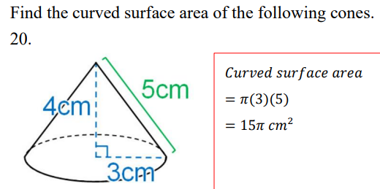

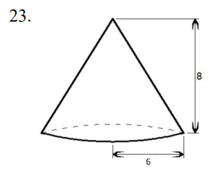























Curved surface area of cone
$$=$$
$$π$$
r
l
$$=$$
$$π$$
(
3)
(
5)
$$=$$
$$π$$
2
15
cm
2
2
2
r
$$+$$
h
$$=$$
l
($pyth. theorem$)
2
2
2
6
$$+$$
8
$$=$$
l
$$π$$
2
$$π$$
Total surface area of cone
$$+$$
r
$$=$$
r
l
2
$$π$$
$$+$$
$$π$$
(
6)
(
$$=$$
(
10)
6)
$$=$$
$$π$$
2
96
cm

Slide 8
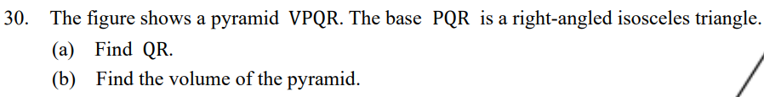

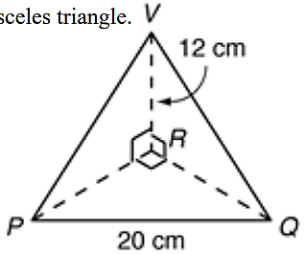















(a)
Since PQR is a right-angled isosceles triangle
QR
$$=$$
PR
2
2
2
($pyth. theorem$)
QR
$$+$$
PR
$$=$$
20
2
$$=$$
2
2QR
20
QR
$$=$$
200
QR
$$=$$
10
2
cm
1
1
2
(b)
Volume of Pyramid
$$=$$
$$×$$
$$×$$
200
$$×$$
12
3
2
$$=$$
400
3
cm

Slide 9

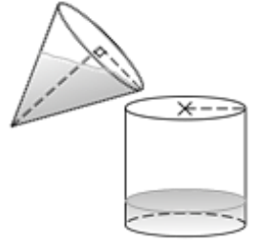












Let h cm be the water level of the cylindrical vessel
1
2
2
$$×$$
$$π$$
$$×$$
$$=$$
$$π$$
(
$$×$$
(
6)
h
6)
13
3
13
h
$$=$$
3
13
$$∴$$
The water level of the cylindrical vessel is cm
3

Slide 10

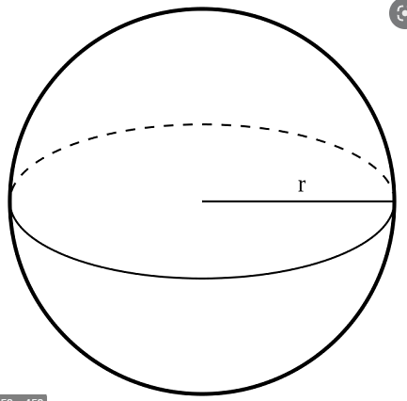





Area and Volume 2
Sphere
4
3
Volume of Sphere
$$π$$
$$=$$
$$×$$
r
3
$$=$$
$$π$$
2
Surface area of Sphere
4
r

Slide 11
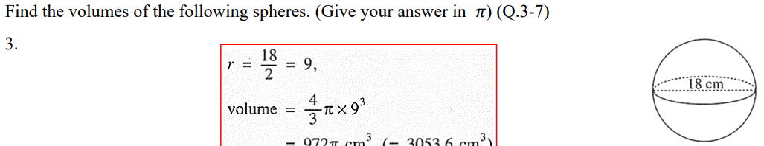



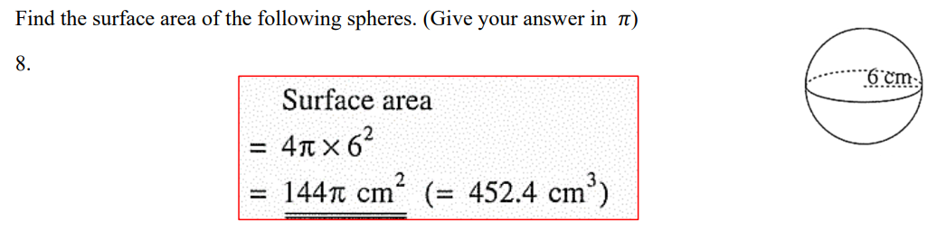


















18
r
$$=$$
$$=$$
9
2
4
3
Volume of Sphere
$$π$$
$$=$$
$$×$$
r
3
4
3
$$×$$
$$π$$
(
$$=$$
9)
3
$$=$$
$$π$$
3
972
cm
$$=$$
$$π$$
2
Surface area of Sphere
4
r
$$=$$
$$π$$
2
4
(
6)
$$=$$
$$π$$
3
144
cm

Slide 12






















Old radius
$$=$$
30
New radius
$$=$$
r
4
3
4
3
Old volume
$$=$$
$$×$$
$$π$$
r
New volume
$$=$$
$$×$$
$$π$$
r
$$×$$
(1
$$+$$
20%)
3
3
Let r cm be the new radius
4
3
4
3
$$×$$
$$π$$
$$×$$
(1
$$+$$
$$=$$
$$×$$
$$π$$
r
(
20%)
30)
3
3
3
$$=$$
r
32400
r
$$=$$
31.9
(cor. to 3 sig. fig.)

Slide 13


















Let r cm be the radius of each small spheres
4
3
4
3
$$×$$
$$π$$
(
$$=$$
$$×$$
$$π$$
r
$$×$$
10)
8
3
3
r
$$=$$
5
$$π$$
(
2
Surface area of large sphere
10)
$$=$$
1256.6
$$=$$
4
2
Surface area of 8 small sphere
$$π$$
$$×$$
8
$$=$$
2513.3
$$=$$
(
4
5)
2513.3
$$−$$
1256.6
Percentage change
$$=$$
$$×$$
100%
1256.6
$$=$$
100%

Slide 14
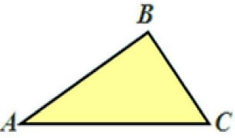
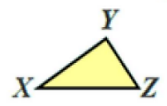











Area and Volume 3
If
$$∆ABC\sim ∆XYZ$$
$$∠A$$
$$=$$
$$∠X$$
$$=$$
$$∠Y$$
$$∠B$$
$$∠C$$
$$=$$
$$∠Z$$
And
AB
BC
CA
$$=$$
$$=$$
XY
YZ
ZX

Slide 15
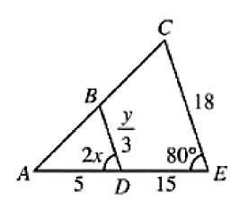
















$$∵$$
$$∆ABD\sim ∆ACE$$
$$∴$$
$$∠ADB$$
$$=$$
$$∠AEC$$
($corr.∠s, \sim ∆s$)
2x
$$=$$
o
80
x
$$=$$
o
40
BD
AD
$$=$$
($corr.sides, \sim ∆s$)
CE
AE
y
3
5
$$=$$
18
15
y
9
$$=$$
3
2
27
y
$$=$$
2

Slide 16
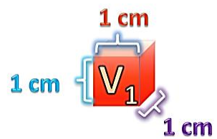
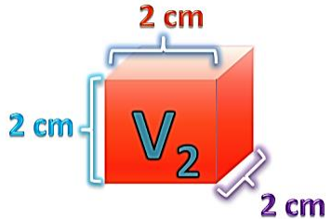




Similar Solid
L
2
A
1
Area ratio $:$
( )
$$=$$
1
L
A
2
2
L
3
V
1
Volume ratio $:$
( )
$$=$$
1
L
V
2
2

Slide 17
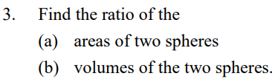
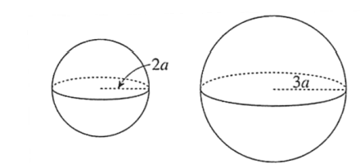














(a)
r
$$:$$
r
$$=$$
$$:$$
1
2
2a
3a
$$=$$
2
$$:$$
3
Ratio of areas
$$=$$
2
$$:$$
2
2
3
$$=$$
4
$$:$$
9
(b)
Ratio of volumes
$$=$$
3
$$:$$
3
2
3
$$=$$
$$:$$
8
27

Slide 18
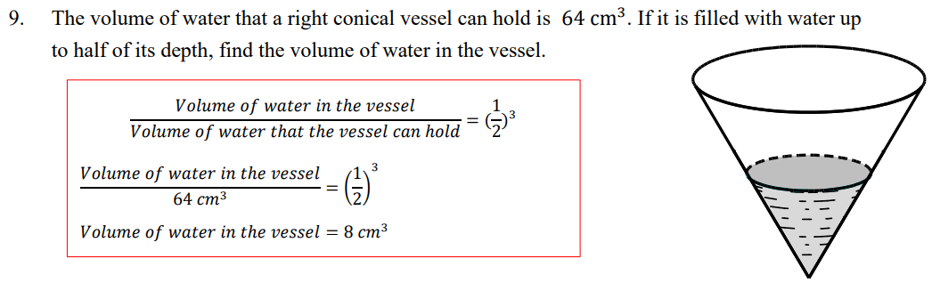







Volume of water in the vessel
1
3
$$=$$
(
)
64
2
1
Volume of water in the vessel
$$=$$
$$×$$
64
8
$$=$$
8
3
cm

Slide 19
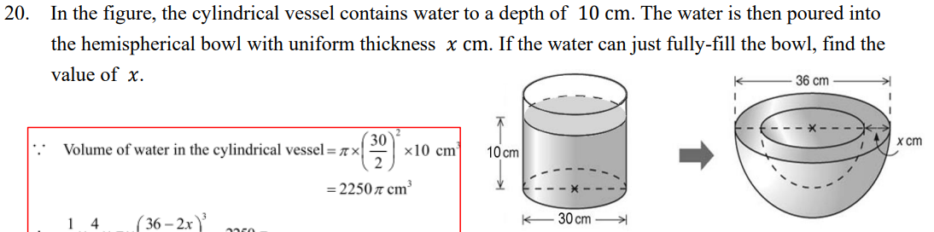

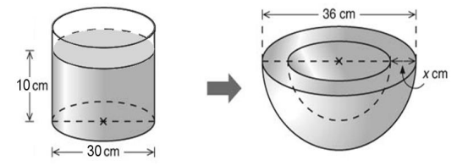




















Volume of water in the cylindrical vessel
30
2
$$=$$
$$π$$
(
)
$$×$$
10
2
$$=$$
$$π$$
3
2250
cm
Volume of water in the bowl
Volume of water in the cylindrical vessel
$$=$$
1
1
36
$$−$$
2x
3
$$×$$
$$×$$
$$π$$
$$×$$
(
)
$$=$$
$$π$$
2250
2
3
2
36
$$−$$
2x
3
(
)
$$=$$
3375
2
x
$$=$$
3

Slide 20
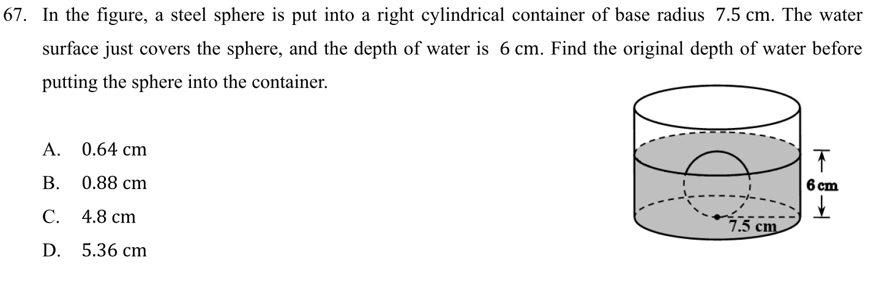

























r
$$=$$
3
Let h cm be the original depth of water
Volume of the water inside the container
Volume of the
cylindrical part in
contact with water
$$=$$
$$−$$
Volume of the sphere
$$−$$
$$=$$
全水體
增體
水體
2
4
3
2
$$×$$
$$π$$
$$π$$
(
$$\text{h}$$
(
$\text{7.5}$)
$$π$$
(
$$\text{6}$$
$$−$$
3)
$$=$$
$\text{7.5}$)
(
)
3
Volume of
the sphere
全水體
$$\text{h}$$
$$=$$
5.36
$$\text{6}$$
$$=$$
$$\text{h}$$
Volume of water that has risen
$$\text{7.5}$$
水體
增體
$$−$$
$$=$$
全水體
增體
水體

